Slide 1
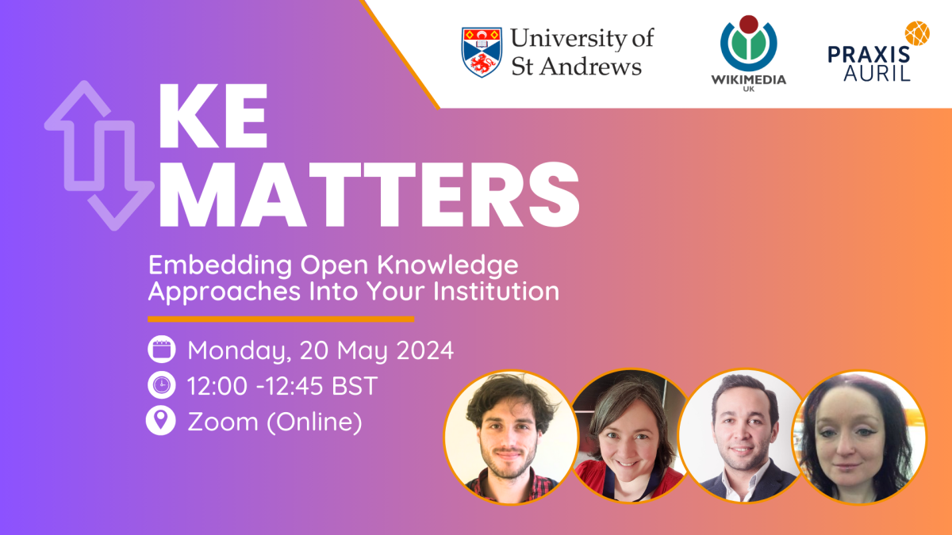

Slide 2


Slide 3
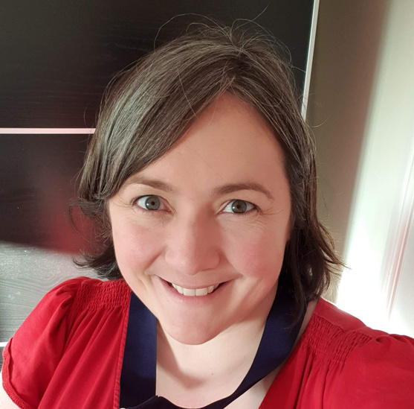
Meet Our Team
The team is currently small but perfectly formed!
Kirsty Ross
Abd Alsattar Ardati
Sara Thomas
Industrial Liaison,
School of Computer Science
Lecturer,
School of Computer Science
Programme Manager,
Wikimedia UK
A microbiologist turned knowledge exchange professional, Kirsty can usually be found lurking on Wikicommons, Wikidata, and introducing new people to the wonders of Wikipedia editing.
Abd is interested in collaborative working in digital research, particularly in communities where digital literacy is a barrier to engagement.
Sara coordinates volunteers & knowledge exchange projects between Wikimedia UK and other orgnasations, with expertise in supporting galleries, libraries, archives and museums.

Slide 4

Our Mission
The Inclusion, Diversity, Equity, and Accessibility in Open Knowledge Network (IDEA Network for short) has one mission:
To make knowledge production inclusive, diverse, equitable, and accessible to all people, regardless of their background, location, or culture.

Slide 5




Our aims
Under-represented groups and knowledge
Increase engagement with, and representation of, marginalised people and subjects. g. via edit-a-thons
Building digital, data, & information literacy
Work with partners to develop digital, data and information literacy through Wikimedia. E.g. via training for staff, students and external community partners
Increase capacity for open knowledge
Develop our capacity to support open knowledge production. E.g. by increasing the number of individuals involved in the Network who would be integrating Wiki projects into their research, teaching and public engagement/knowledge exchange practice.

Slide 6





What have we tried so far at St Andrews?
Wikipedia in universities, and at St Andrews in particular, isn’t new. Ad hoc advocacy by passionate individuals is important. But by bringing folks together, we can achieve so much more in collaboration!
Continuous Learning
Teaching
This has primarily focused on training of new editors, both inside the University and outwith. E.g. European Researchers’ Night.
We have also integrated Wiki projects into modules in the School of Computer Science, as well as into optional programmes over the summer .
Research
Knowledge Exchange
We are also running research projects to understand how university research is represented on Wikipedia, and digital research more broadly.
We also collaborate with external organisations, such as GlobalShare, to offer training courses and collaborative projects.

Slide 7
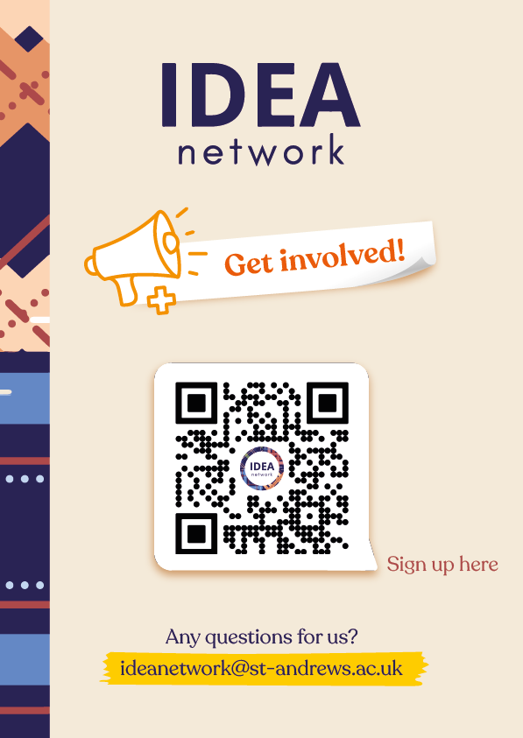


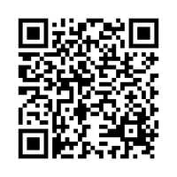
IDEA Network membership
Optional 30 min once every three weeks.
IDEA Network Membership
We will offer a guide on how to take advantage of knowledge exchange opportunities.
Steering Group
1~2 hours once every three weeks.
Steering Group
Notes:
https://standrews.eu.qualtrics.com/jfe/form/SV_e3UVDHHCm0ghese

Slide 8





Contact Us
If you would like our support in building an open knowledge community in your own organisation, then please do get in touch. We can then add you to our Teams channels.
We also offer:
  drop in sessions after each of our Steering Group meetings
  ad hoc training and development sessions.
Wiki site coming soon!
ideanetwork@st-andrews.ac.uk
JCB, North Haugh, St Andrews

Slide 9




Thank You
For Your Attention

